Slide 1
Python Programming
I UNIT

Slide 2
List of contents
Introduction to python
Writing first python program
Data types in python
Operators
Input and Output
Control Statements
Arrays in python

Slide 3
Chapter 1
Introduction to python

Slide 4
Introduction to python
Functional or Procedural programming languages like C, FORTARN, Pascal etc
Object oriented programming languages like Java , .NET
C++ and Python are both procedural and object oriented programming languages

Slide 5
History of Python
Python was developed by Guido Van Rossum in the year 1991 at center for Mathematics and Computer Science managed by Dutch Government.
He was working on a project to develop system utilities in C where he had to interact with Bourne shell available in UNIX.
He felt the necessity of developing a language that would fill the gap between C and the shell.
So he created python

Slide 6

He picked the name Python form the TV show, “Monty Python’s Flying Circus”.
First release of python to public on Feb 20,1991
Logo of python is two intertwined snakes
Official site for python is www.python.org

Slide 7
Features of python
Simple
Easy to learn
Open source
High level language
Dynamically typed language
Platform independent
Python compiler generates byte code, by using PVM any one or any where we can run this byte code instruction
Portable
Pyhon program yields the same results on any computer
Procedural and object oriented

Slide 8
Interpreted
Python code or program is called as source code.
Python compiler translates the source code into an intermediate code called byte code
This byte code is then executed by python virtual machine (PVM)
PVM is an interpreter which coverts byte code into machine instructions
Extensible
The programs written in C or C++ can be integrated into python and execute on PVM
Embeddable
We can insert python programs into C or C++
Huge library
Scripting language
Python uses an interpreter to translate source code into machine code on the fly (While running)
For example PHP that performs supporting task of taking input from an HTML page and send it to web server
Python is used on the internet to support other software
Database connectivity
Python provides interfaces to connect its programs to all major databases like Oracle, Sybase or MySql
Scalable
Use the features of the new platform effectively
Batteries included
Huge Batteries or packages

Slide 9
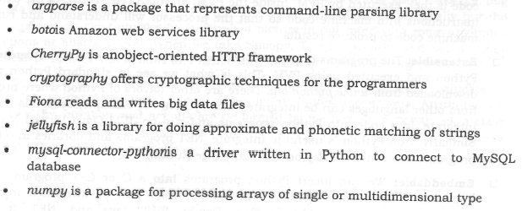

Slide 10
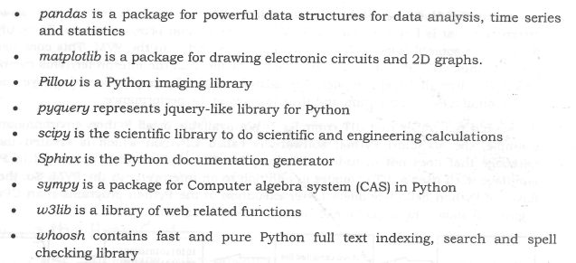

Slide 11
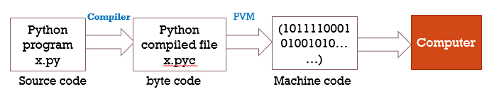
Execution of python program
Python source code file should be with dot extension py (i.e., .py)
For example x.py is our python source code
For compiling type the following line in command prompt
python x.py
When you do this you can't find .pyc file, because all this shown in the above diagram happens internally

Slide 12
To separately create .pyc file, do the following in command line
python –m py_compile x.py
Here –m represents module and the module name is py_compile
This creates a directory with name __pycache__ where it stores the .pyc file
In order to execute, do the following in command line
python x.cpython-38.pyc
Viewing the byte code
python –m dis x.py

Slide 13
Flavors of python
Cpython
This is the standard python compiler implemented in C language.
This can be downloaded for python official website
Jython
This is earlier known as JPython.
Java compiler first compiles the python program into java byte code. Then the byte code is executed by JVM to produce output
IronPython
This is the implementation of python language for .NET framework
Written in C# (C Sharp)
PyPy
This is python implementation using python language
It is written in RPython
RPython is suitable for creating language interpreters
PyPy programs run fast because a JIT (Just in Time) compiler is added to PVM.

Slide 14
RubyPython
This is a bridge between Ruby and Python interpreters
This flavor of python can be downloaded form https://rubygems.org/gems/rubypython/versions/
StacklessPython
Small tasks which should run individually are called tasklets on CPU via channels
A channel is a manager that takes care of scheduling tasklets
A thread runs hundreds of tasklets
StacklessPython helps in creating threads and stacklets
Pythonxy
Science and engineering packages
AnacondaPython
Large scale data processing, predictive analytics and scientific computing

Slide 15
Frozen binaries
Converting the python programs into true executable is called Frozen binaries
All the .pyc files, related python library and PVM will be converted into a single executable file
Software is needed to create
py2exe for windows
pyinstaller for UNIX or LINUX

Slide 16
Memory management in python
Memory allocation and deallocation in python are done during run time automatically
Memory manager inside PVM allocates memory required for objects created in a python program
All objects are stored on a separate memory called heap

Slide 17
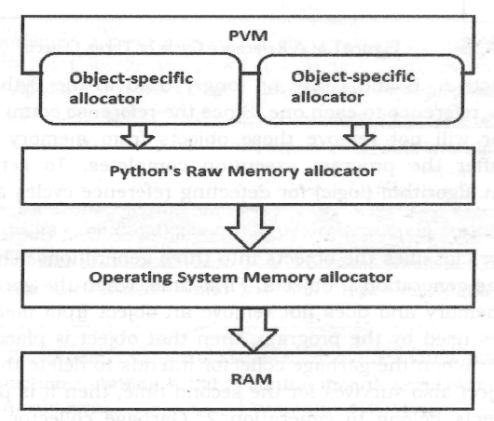

Slide 18
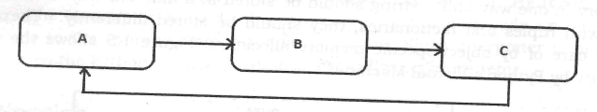
Garbage collection in python
It is a module useful to delete objects form memory which are not used in the program.
The module that represents the garbage collector is named as gc
Garbage collector maintains a count for each object regarding how many times that object is referenced or used
Problem: A reference cycle is a cycle of references pointing to the first object form last object
These objects are not removed even though they are not in use, because each object has one reference.
To solve this problem Garbage collector uses an algorithm for detecting reference cycles and removing objects in the cycle.

Slide 19
Garbage collector classifies objects in to 3 generations
Newly created objects are considered as generation 0
The objects got survived when GC went to delete them for the first time, they are considered as generation 1
The objects got survived when GC went to delete them for second time or more, they are considered as generation 2
GC will delete new objects which are not referenced in the program rather than the older objects
GC depends up on a number called threshold. This number represents the frequency of how many times the GC removed the objects.
Python scheduler activate garbage collector, when
number of allocations – number of deallocations > Threshold number

Slide 20
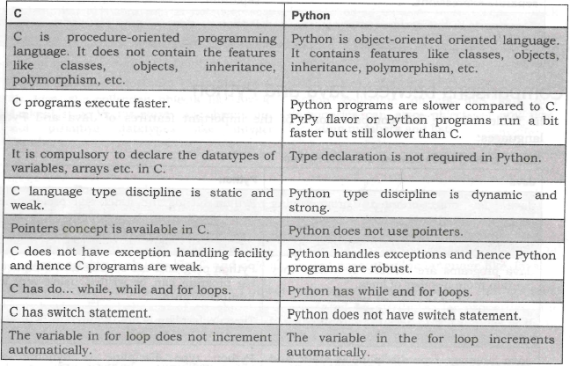
Comparison between C and python

Slide 21
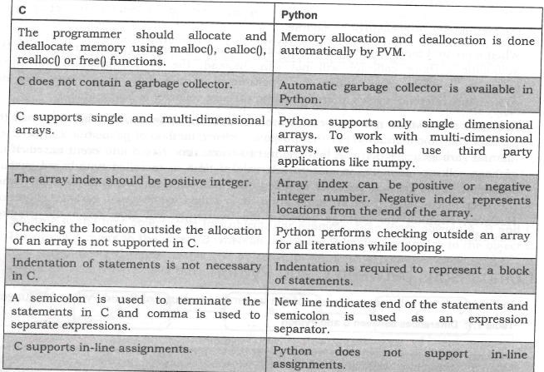

Slide 22
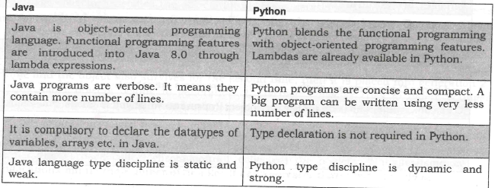
Comparison between java and python

Slide 23
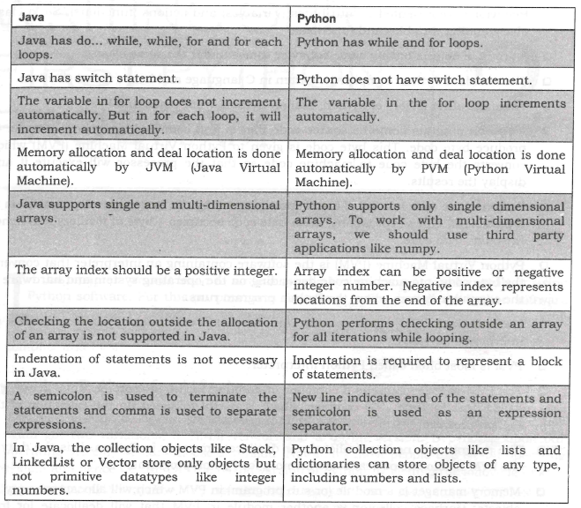

Slide 24
Chapter 2
Writing first python program

Slide 25
Installing python for windows
Download python from www.python.org and install it.
Testing the installation in windows
IDLE (Python 3.8 64-bit)
Python 3.8 (64-bit)
Python 3.8 Manuals (64-bit)
Python 3.8 Module Docs (64-bit)
Verifying the path to python
Advanced System settings - Environment variables - user variables – path

Slide 26
Installing various modules
Use pip (python installation of packages) in command prompt
Example: pip install numpy
numpy: To create multi-dimensional arrays
pandas: used by data scientists and data analysts
xlrd: used to retrieve data from MS Excel spreadsheet files
matplotlib: used to produce good quality 2D graphs
Verifying Installed packages
In python shell type “help(‘modules’)”
>>>help(‘modules’)

Slide 27
Writing first python program
Executing a python program
Using python’s command line window
Using python’s IDLE graphics window
Using from system command prompt
Getting help in python
>>>help()
To exit from help simply press enter without typing anything
Getting python documentation help
Open IDLE or shell select help --> Python Docs

